Slide 1
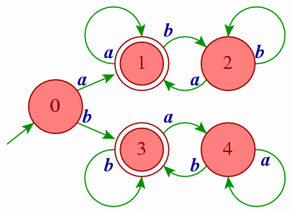
Unit-2
Regular Languages & Finite Automata

Slide 2
Languages

Slide 3
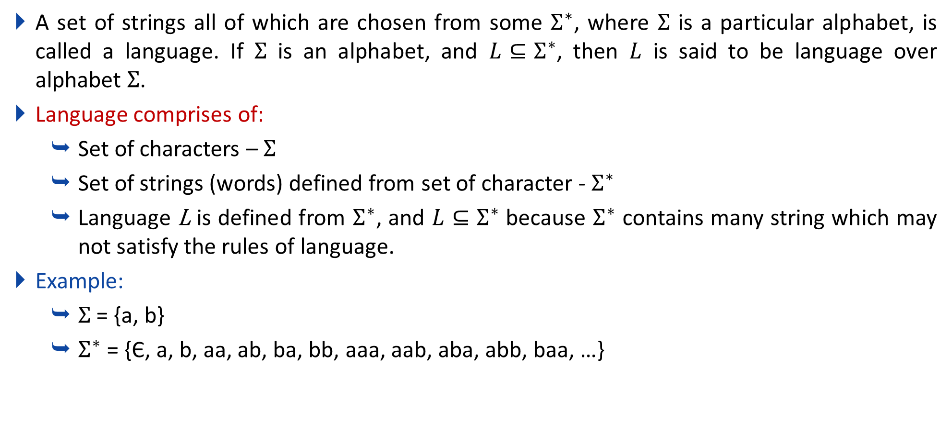
Language
A set of strings all of which are chosen from some $Σ^{∗}$, where $Σ$ is a particular alphabet, is called a language. If $Σ$ is an alphabet, and $L⊆Σ^{∗}$, then $L$ is said to be language over alphabet $Σ$.
Language comprises of:
  Set of characters – $Σ$
  Set of strings (words) defined from set of character - $Σ^{∗}$
  Language L is defined from $Σ^{∗}$, and $L⊆Σ^{∗}$ because $Σ^{∗}$ contains many string which may not satisfy the rules of language.
Example:
  $Σ$ = {a, b}
  $Σ^{∗}$ = {Є, a, b, aa, ab, ba, bb, aaa, aab, aba, abb, baa, …}

Slide 4
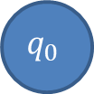

Difference between epsilon and phi
Epsilon(Є) is a 0 length string, whereas phi(ɸ) is a null, i.e. no string.
0,1
$$q_{0}$$
$$q_{0}$$
Epsilon(Є)
phi(ɸ)

Slide 5
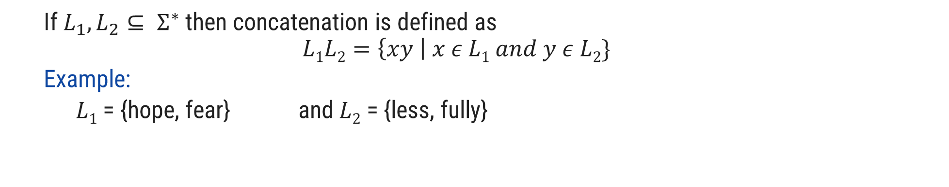
Operations over Language
Operations over the language are:
Concatenation
Union
* (Kleene closure)
+ (Positive closure)
  If $L_{1}, L_{2}⊆ Σ^{∗}$ then concatenation is defined as
  $$L1L2=\left\{xy \right| x ε L1 and y ε L2\}$$
  Example:
    $L1$ = {hope, fear} and $L2$ = {less, fully}
hopeless
$L1L2$ = {hopeless, hopefully, fearless, fearfully}

Slide 6

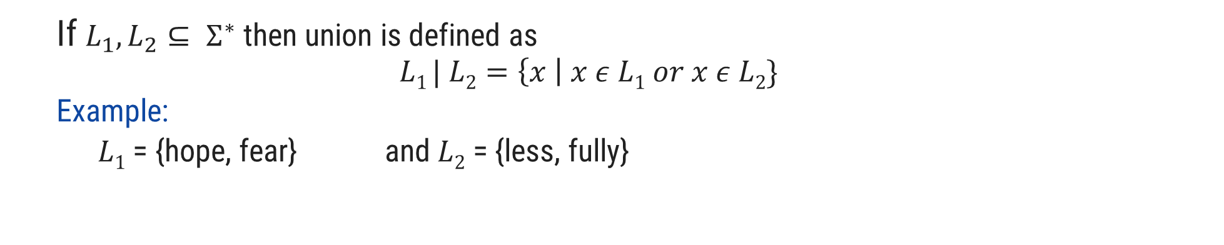
Operations over Language
Operations over the language are:
Concatenation
Union
* (Kleene closure)
+ (Positive closure)
  If $L_{1}, L_{2}⊆ Σ^{∗}$ then union is defined as
  $$L1 | L2=\left\{x \right| x ε L1 or x ε L2\}$$
  Example:
    $L1$ = {hope, fear} and $L2$ = {less, fully}
$L1 | L2$ = {hope, fear, less, fully}

Slide 7

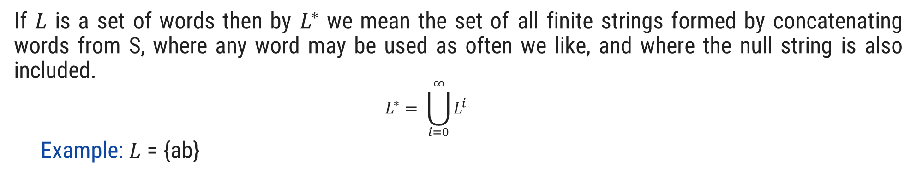
Operations over Language
Operations over the language are:
Concatenation
Union
* (Kleene closure)
+ (Positive closure)
    If $L$ is a set of words then by $L^{∗}$ we mean the set of all finite strings formed by concatenating words from S, where any word may be used as often we like, and where the null string is also included.
    $$L^{∗}= \bigcup_{i=0}^{∞}{L^{i}}$$
    Example: $L$ = {ab}
  $L$* = {^, ab, abab, ababab, abababab, ….}

Slide 8


Operations over Language
Operations over the language are:
Concatenation
Union
* (Kleene closure)
+ (Positive closure)
  If $L$ is a set of words then by $L^{+}$ we mean the set of all finite strings formed by concatenating words from L, where any word may be used as often we like, and where the null string is not included.
    $$L^{+}= \bigcup_{i=1}^{∞}{L^{i}}$$
    Example:$L$ = {ab}
  $L^{+}$ = {ab, abab, ababab, abababab, ….}

Slide 9
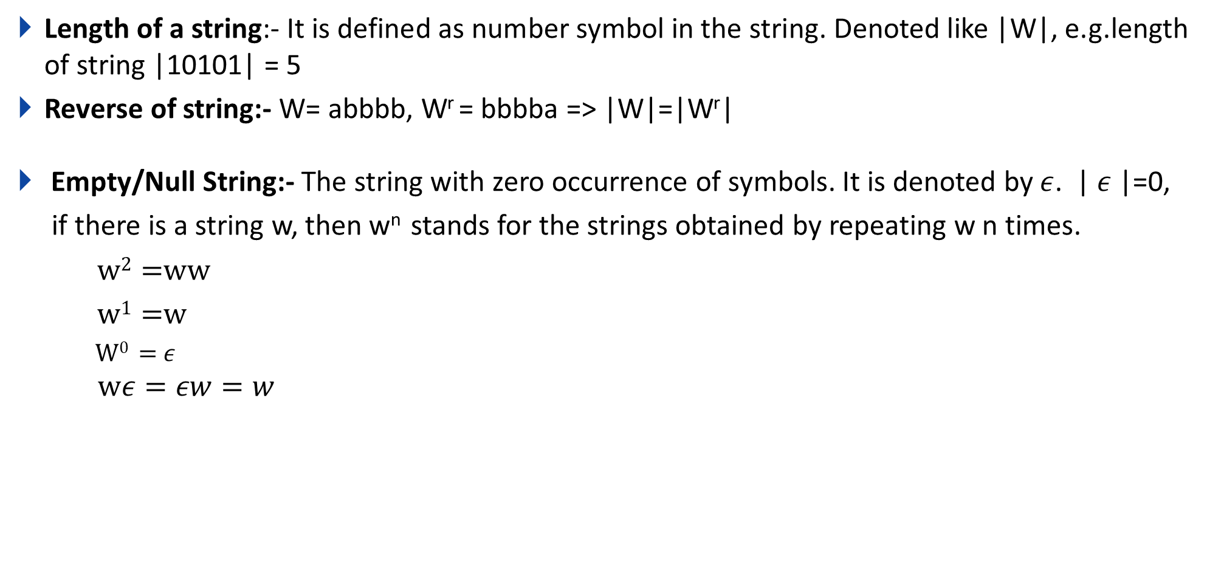
Some Basic operations on string
Length of a string:- It is defined as number symbol in the string. Denoted like |W|, e.g.length of string |10101| = 5
Reverse of string:- W= abbbb, W^{r} = bbbba => |W|=|W^{r}|
Empty/Null String:- The string with zero occurrence of symbols. It is denoted by $ε$. | $ε$|=0,
if there is a string w, then w^{n} stands for the strings obtained by repeating w n times.
w² =ww
w¹ =w
W⁰ = $ε$
$$wε=εw=w$$

Slide 10
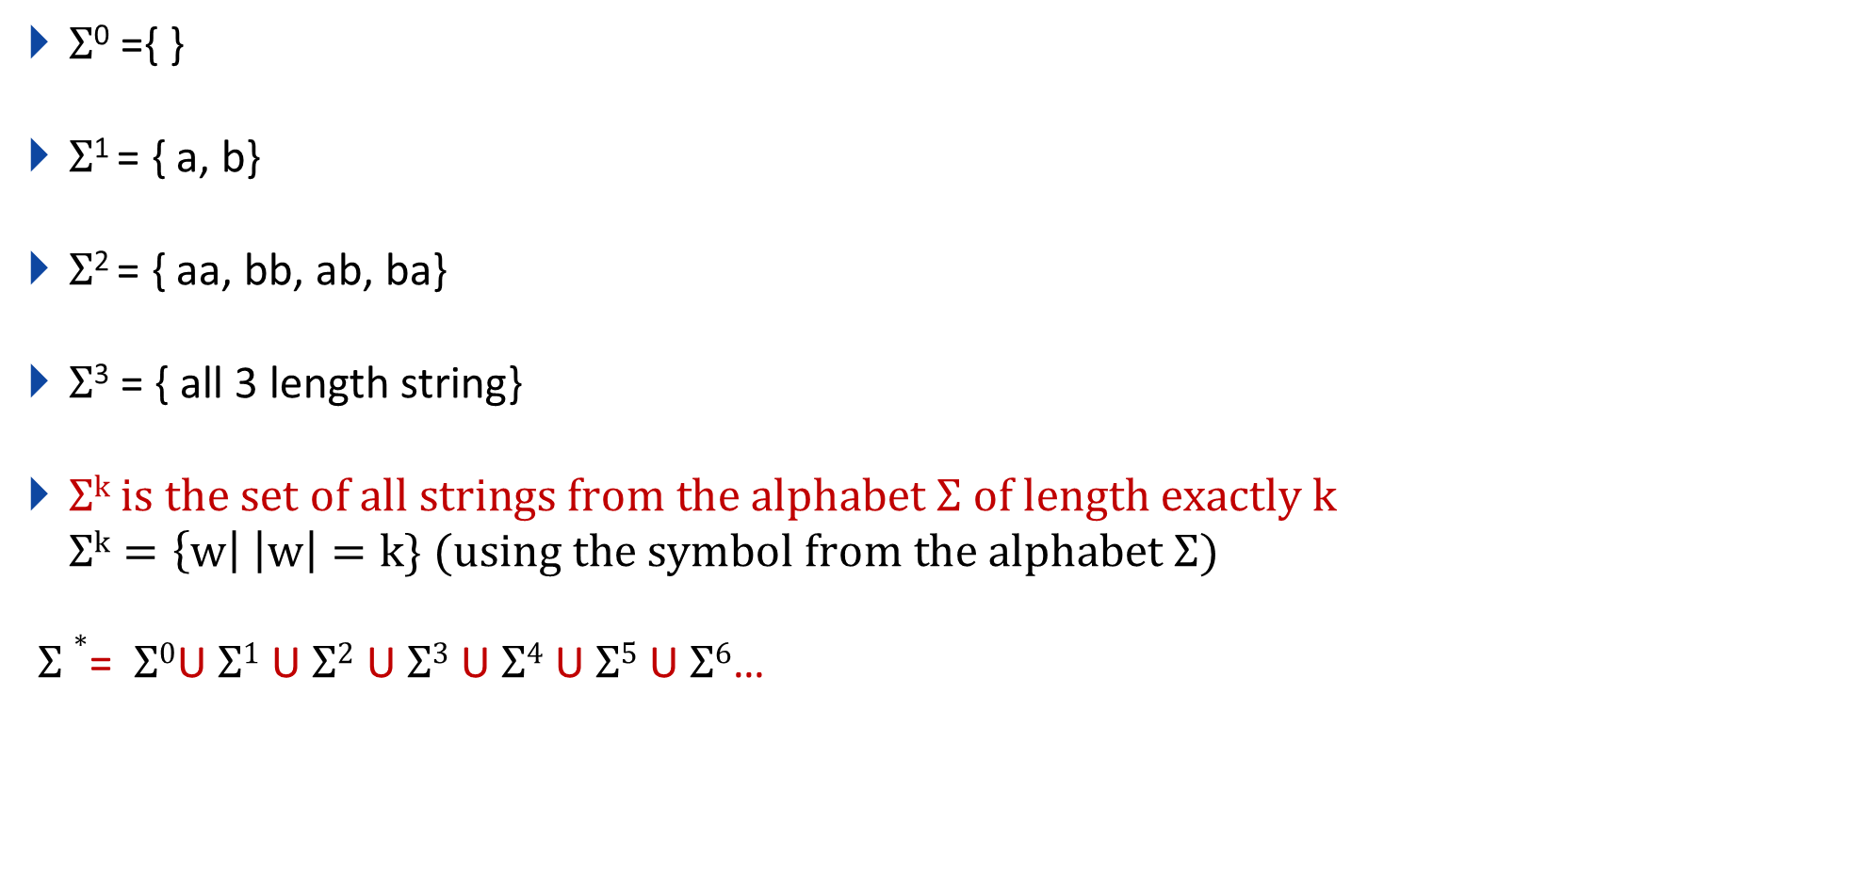
Q. If $Σ$={a,b} then, find the following?
$Σ$⁰ ={ }
$Σ$¹ = { a, b}
$Σ$² = { aa, bb, ab, ba}
$Σ$³ = { all 3 length string}
$Σk is the set of all strings from the alphabet Σ of length exactly k$
$$Σk=\left\{w\right| \left|w\right|=k\} (using the symbol from the alphabet Σ)$$
$Σ∗$= $Σ0$U$Σ1$ U$Σ2$ U$Σ3$ U$Σ4$ U$Σ5$ U$Σ6$…

Slide 11
Regular Expression

Slide 12
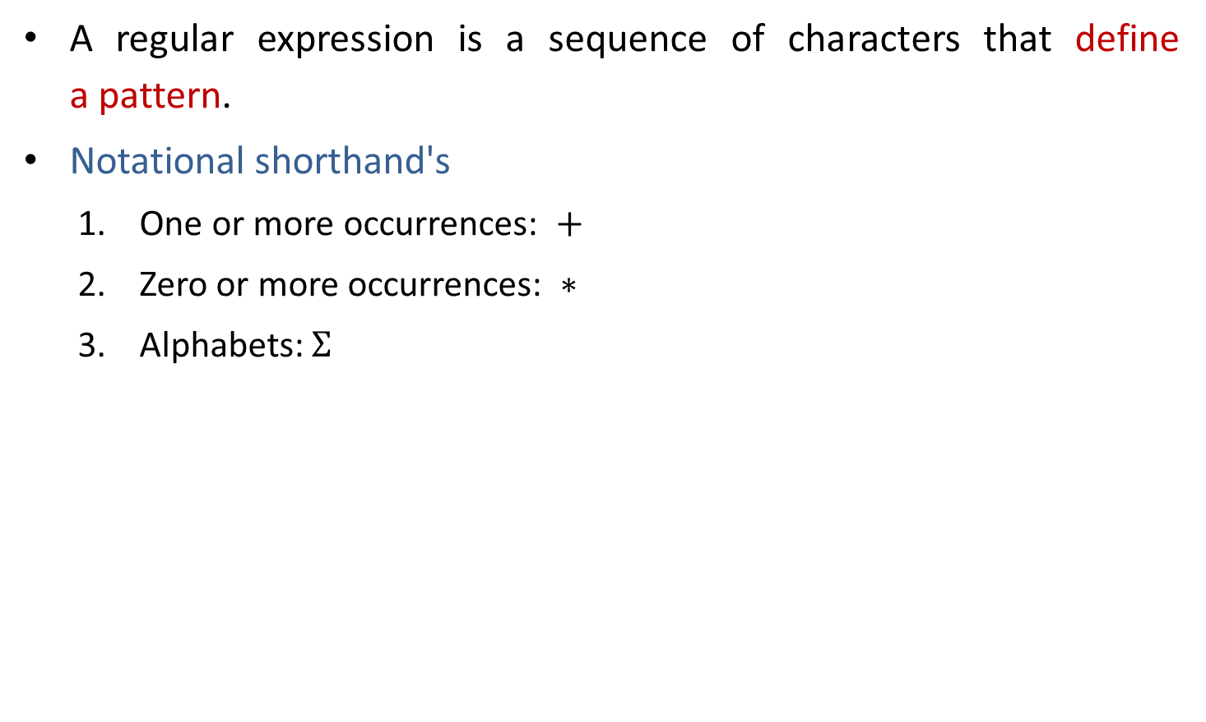
Regular expression
A regular expression is a sequence of characters that define a pattern.
Notational shorthand's
  One or more occurrences: $+$
  Zero or more occurrences: $∗$
  Alphabets: $Σ$

Slide 13
Regular expression
a*
L = Zero or More Occurrences of a =
*
𝜖
a
aa
aaa
Infinite …..
aaaa
aaaaa…..

Slide 14
Regular expression
a⁺
L = One or More Occurrences of a =
+
a
aa
aaa
Infinite …..
aaaa
aaaaa…..

Slide 15
Precedence and associativity of operators
Operator | Precedence | Associative
Kleene * | 1 | left
Concatenation | 2 | left
Union | or + | 3 | left

Slide 16

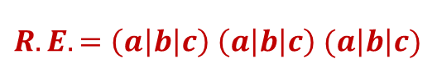



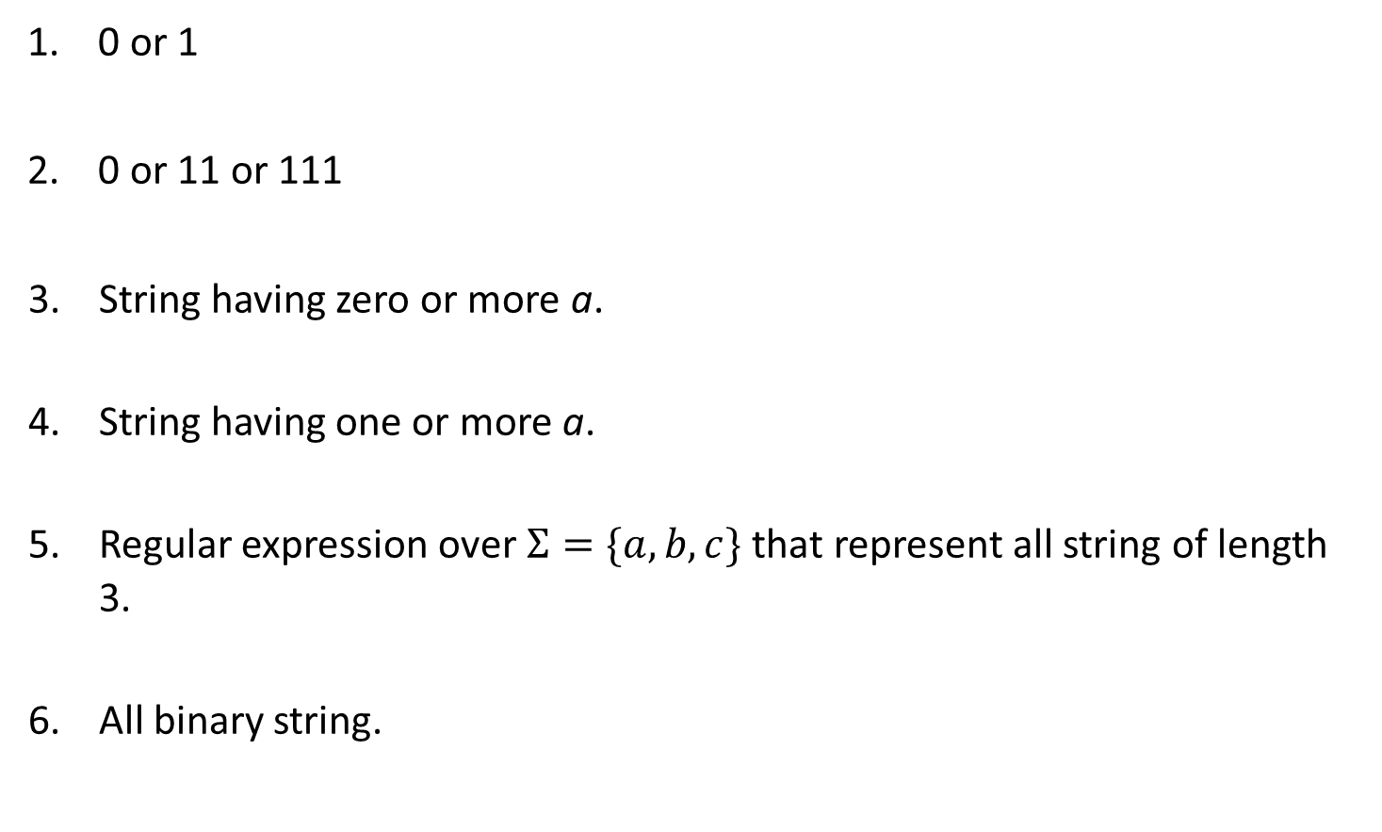



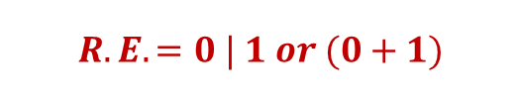

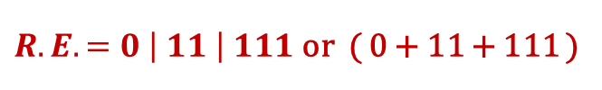

Regular expression examples
0 or 1
0 or 11 or 111
String having zero or more a.
String having one or more a.
Regular expression over $Σ=\{a,b,c\}$ that represent all string of length 3.
All binary string.
$$Strings: 0, 1$$
$$R.E. =0 | 1 or (0+1)$$
$$Strings: 0, 11, 111$$
$R.E. =0 \left| 11 \right| 111$ or ( 0 + 11 + 111 )
$$Strings: ε,a, aa, aaa, aaaa…..$$
$$R.E. =a∗$$
$$Strings:a, aa, aaa, aaaa…..$$
$$R.E. =a+$$
$$Strings:abc, bca, bbb, cab, aba….$$
$$R.E. =\left(a\left|b\right|c\right) \left(a\left|b\right|c\right) (a\left|b\right|c)$$
$$Strings: 0, 11, 101, 10101, 1111…$$
$$R.E. =(0 | 1)+$$

Slide 17
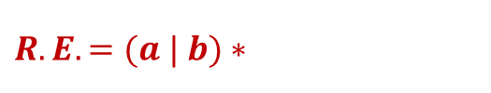
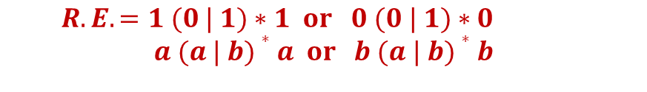
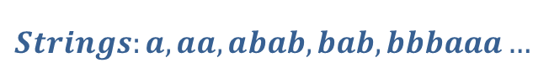






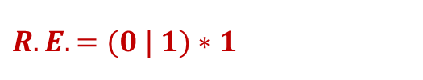

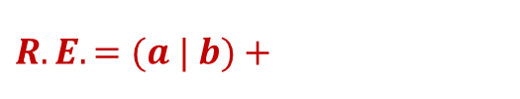
Regular expression examples
0 or more occurrence of either a or b or both
1 or more occurrence of either a or b or both
Binary no. ends with 0
Binary no. ends with 1
Binary no. starts and ends with 1
String starts and ends with same character
$$Strings:ε,a, aa, abab, bab…$$
$$R.E. =(a | b)∗$$
$$Strings:a, aa, abab, bab, bbbaaa…$$
$$R.E. =(a | b)+$$
$$Strings: 0, 10, 100, 1010, 11110…$$
$R.E. =(0 | 1)∗$ $0$
$$Strings:1, 101, 1001, 10101, …$$
$$R.E. =(0 | 1)∗1$$
$$Strings: 11, 101, 1001, 10101, …$$
$R.E. =1 (0 | 1)∗$ $1| 1$
$$Strings:00, 101, aba, baab…$$
$$R.E. =1 (0 | 1)∗1 or 0 (0 | 1)∗0$$
$$a (a | b)∗a or b (a | b)∗b$$

Slide 18


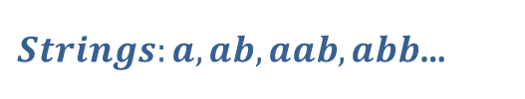

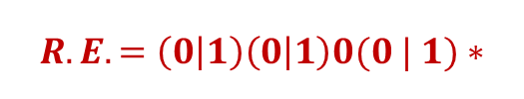
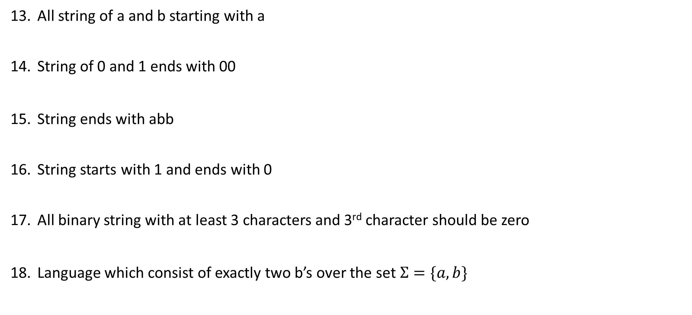


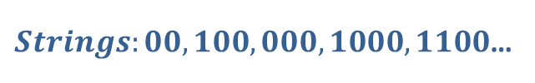


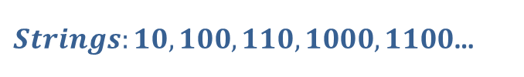

Regular expression examples
All string of a and b starting with a
String of 0 and 1 ends with 00
String ends with abb
String starts with 1 and ends with 0
All binary string with at least 3 characters and 3rd character should be zero
Language which consist of exactly two b’s over the set $Σ=\{a,b\}$
$Strings:a,ab,aab,abb$…
$$R.E. =a(a | b)∗$$
$Strings:00,100,000,1000,1100$…
$$R.E. =(0 | 1)∗00$$
$Strings:abb,babb, ababb$…
$$R.E. =(a | b)∗abb$$
$Strings:10,100,110,1000,1100$…
$$R.E. =1(0 | 1)∗0$$
$Strings:000,100,1100,1001$…
$$R.E. =\left(0 | 1\right)\left(0 | 1\right)0(0 | 1)∗$$
$Strings:bb,bab,aabb,abba$…
$$R.E. =a∗b a∗b a∗$$

Slide 19
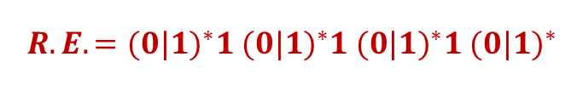
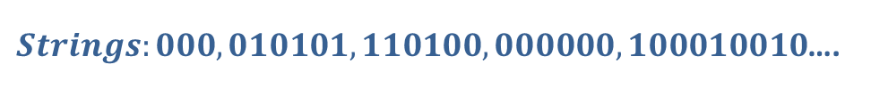


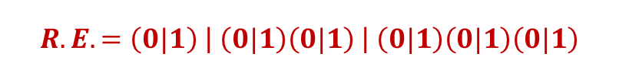
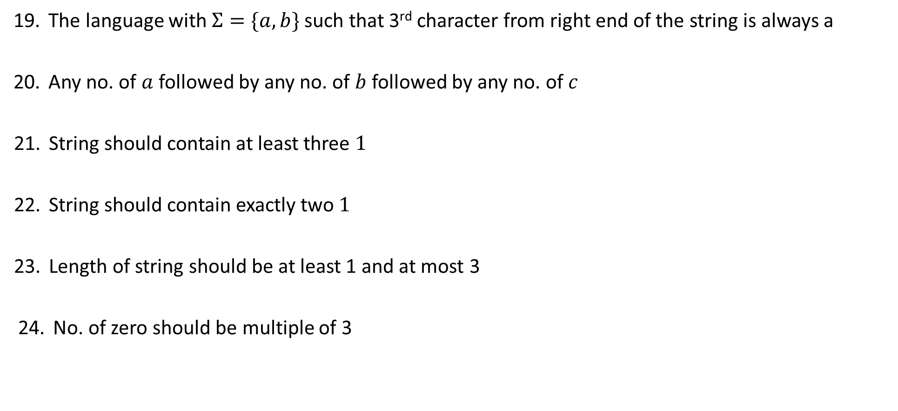

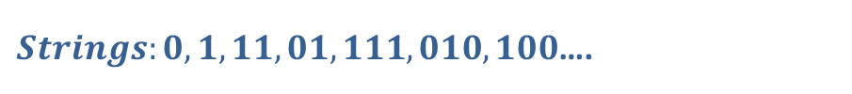


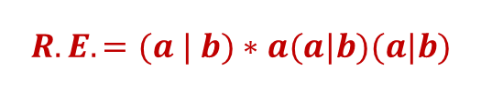


Regular expression examples
The language with $Σ=\{a,b\}$ such that 3rd character from right end of the string is always a
Any no. of $a$ followed by any no. of $b$ followed by any no. of $c$
String should contain at least three $1$
String should contain exactly two $1$
Length of string should be at least 1 and at most 3
No. of zero should be multiple of 3
$Strings:aaa,aba,aaba,abb$…
$$R.E. =(a | b)∗a(a|b)(a|b)$$
$Strings:ε,abc,aabbcc,aabc,abb$…
$$R.E. =a∗b∗c∗$$
$Strings:111,01101,0101110$….
$$R.E. ={(0|1)}^{∗}1{ (0|1)}^{∗}1{ (0|1)}^{∗}1 {(0|1)}^{∗}$$
$Strings:11,0101,1100,010010,100100$….
$$R.E. =0^{∗}10^{∗}10^{∗}$$
$Strings:0,1,11,01,111,010,100$….
$$R.E. =\left(0|1\right) \left| \left(0|1\right)\left(0|1\right) \right| \left(0|1\right)\left(0|1\right)\left(0|1\right)$$
$Strings:000,010101,110100,000000,100010010$….
$$R.E. ={(1^{∗}01^{∗}01^{∗}01^{∗})}^{∗}$$

Slide 20





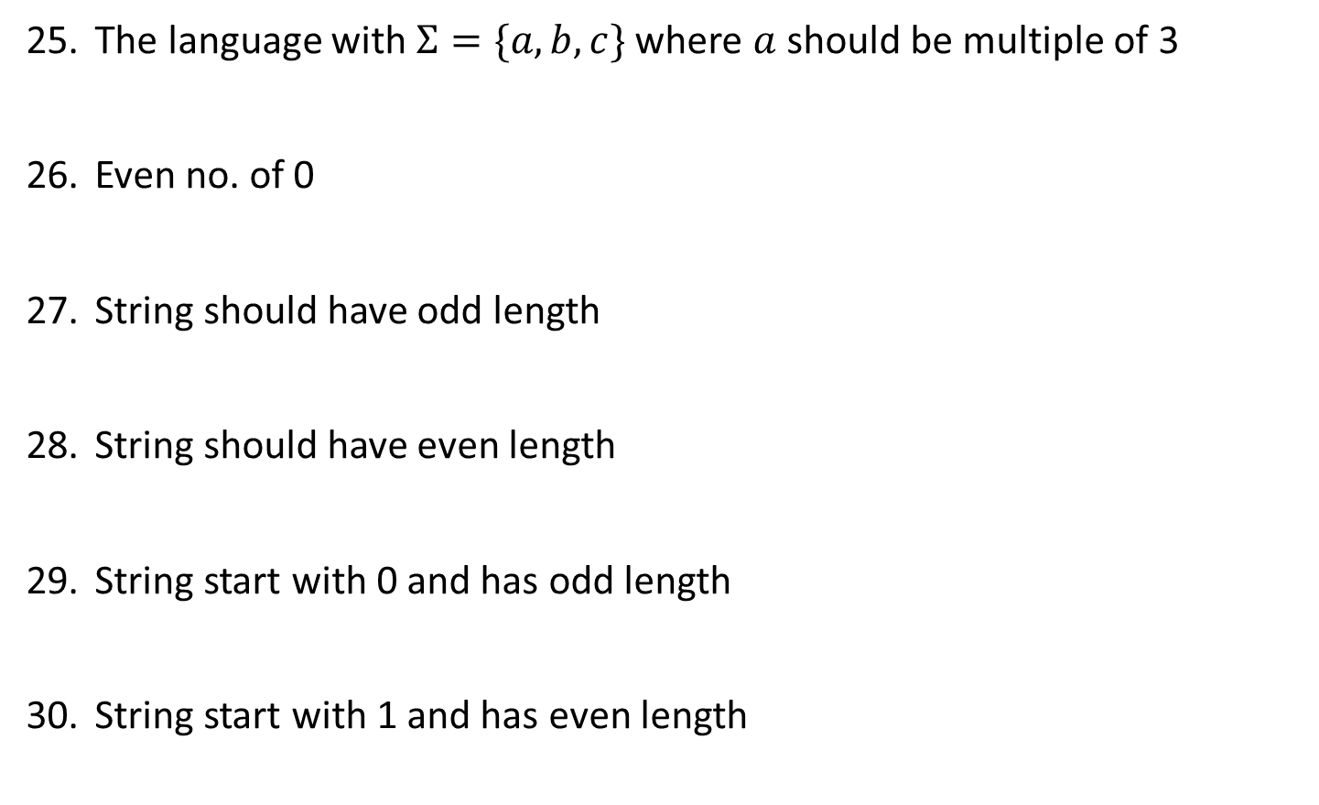

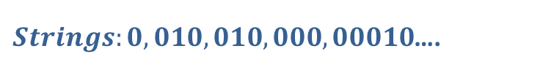


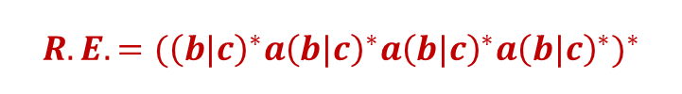


Regular expression examples
The language with $Σ=\{a,b,c\}$ where $a$ should be multiple of 3
Even no. of 0
String should have odd length
String should have even length
String start with 0 and has odd length
String start with 1 and has even length
$$Strings:aaa, baaa,bacaba,aaaaaa..$$
$$R.E. ={({\left(b|c\right)}^{∗}a{\left(b|c\right)}^{∗}a{\left(b|c\right)}^{∗}a{\left(b|c\right)}^{∗})}^{∗}$$
$Strings:00,0101,0000,100100$….
$$R.E. ={(1^{∗}01^{∗}01^{∗})}^{∗}$$
$Strings:0,010,110,000,10010$….
$$R.E. ={\left(0|1\right) (\left(0 | 1\right)(0|1))}^{∗}$$
$Strings:00,0101,0000,100100$….
$$R.E. ={ (\left(0 | 1\right)(0|1))}^{∗}$$
$Strings:0,010,010,000,00010$….
$$R.E. ={\left(0\right) (\left(0 | 1\right)(0|1))}^{∗}$$
$Strings:10,1100,1000,100100$….
$$R.E. ={ 1(0|1)(\left(0 | 1\right)(0|1))}^{∗}$$

Slide 21

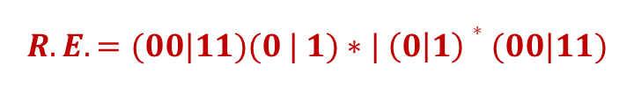


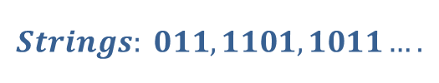
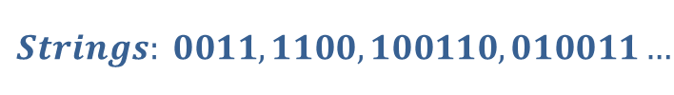


Regular expression examples
All string begins or ends with 00 or 11
Language of all string containing both 11 and 00 as substring
String ending with 1 and not contain 00
Language of C identifier
$$Strings: 00101, 10100,110,01011…$$
$$R.E. =(00|11)(0 | 1)∗| \left(0 | 1\right)∗(00|11)$$
$$Strings: 0011, 1100,100110,010011…$$
  $$R.E. ={((0|1)}^{∗}00{(0|1)}^{∗}11{(0|1)}^{∗}) |{ ((0|1)}^{∗}11{(0|1)}^{∗}00{(0|1)}^{∗})$$
$$Strings: 011, 1101,1011….$$
$$R.E. =\left(1 | 01\right)+$$
$$Strings:area, i, redious, grade1….$$
$$R.E. ={(_+L)(_ + L +D)}^{∗}$$
$$where L is Letter \& D is digit$$

Slide 22
Finite Automata

Slide 23
Finite Automata
Finite Automata(FA) is the simplest machine to recognize patterns.
The finite automata or finite state machine is an abstract machine that has five elements or tuples.
It has a set of states and rules for moving from one state to another but it depends upon the applied input symbol. Basically, it is an abstract model of a digital computer.
Types of Finite Automata:
  Language Recognizer (Compiler)
    DFA
    NFA
  Output Generator (Digital circuit)
    Mealy Machine
    Moore Machine

Slide 24
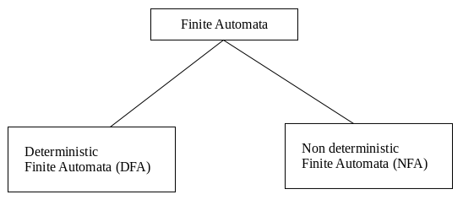
Types of Finite Automata:
DFA: Deterministic refers to the uniqueness of the computation. In a DFA, for a particular input character, the machine goes to one state only. A transition function is defined on every state for every input symbol. DFA does not accept the null move.
NFA: NFA stands for non-deterministic finite automata. It is used to transmit any number of states for a particular input. It can accept the null move. i.e. it can move forward without reading any input.

Slide 25
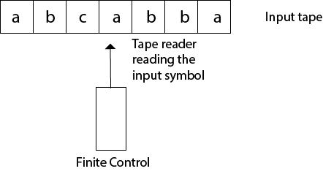
Finite Automata Model:
Finite automata can be represented by input tape and finite control.
Input tape: It is a linear tape having some number of cells. Each input symbol is placed in each cell.
Finite control: The finite control decides the next state on receiving particular input from input tape. The tape reader reads the cells one by one from left to right, and at a time only one input symbol is read.

Slide 26
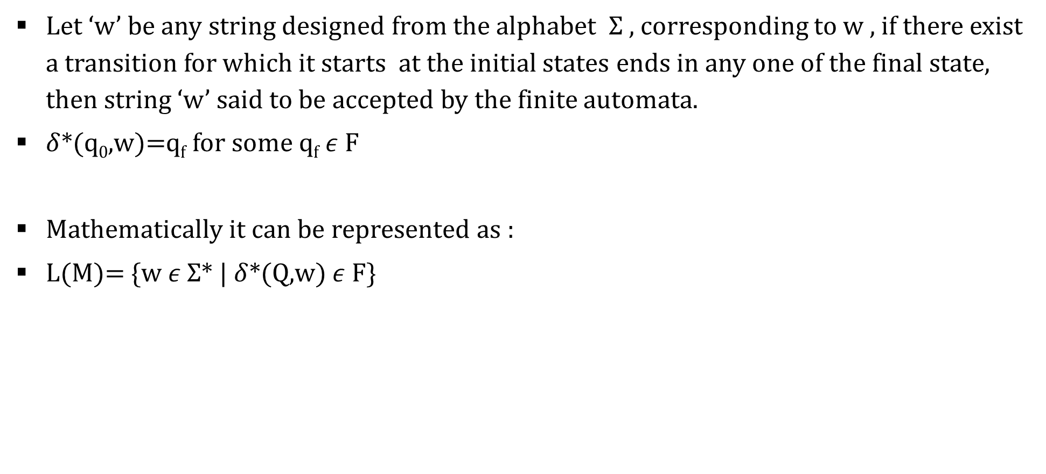
Acceptance by DFA
Let ‘w’ be any string designed from the alphabet $Σ$ , corresponding to w , if there exist a transition for which it starts at the initial states ends in any one of the final state, then string ‘w’ said to be accepted by the finite automata.
$δ$*(q₀,w)=q_{f} for some q_{f} $ε$ F
Mathematically it can be represented as :
L(M)= {w $ε$ $Σ$* | $δ$*(Q,w) $ε$ F}

Slide 27
Applications of DFA
Lexical analysis phase of a compiler.
Design of digital circuit.
String matching.
Communication Protocol for information exchange.

Slide 28
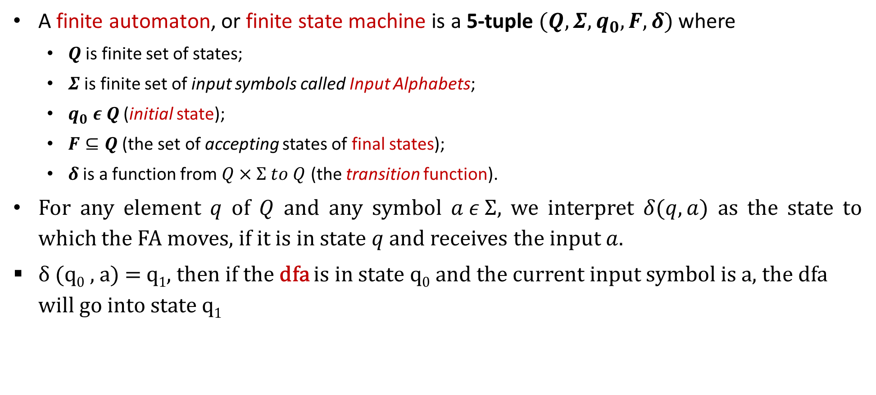
Deterministic Finite Automata
A finite automaton, or finite state machine is a 5-tuple $(Q,Σ,q_{0},F,δ)$ where
  $Q$ is finite set of states;
  $Σ$ is finite set of input symbols called Input Alphabets;
  $q_{0} ε Q$ (initial state);
  $F⊆Q$ (the set of accepting states of final states);
  $δ$ is a function from $Q×Σ to Q$ (the transition function).
For any element $q$ of $Q$ and any symbol $a ε Σ$, we interpret $δ(q,a)$ as the state to which the FA moves, if it is in state $q$ and receives the input $a$.
δ (q₀ , a) = q₁, then if the dfa is in state q₀ and the current input symbol is a, the dfa will go into state q₁

Slide 29

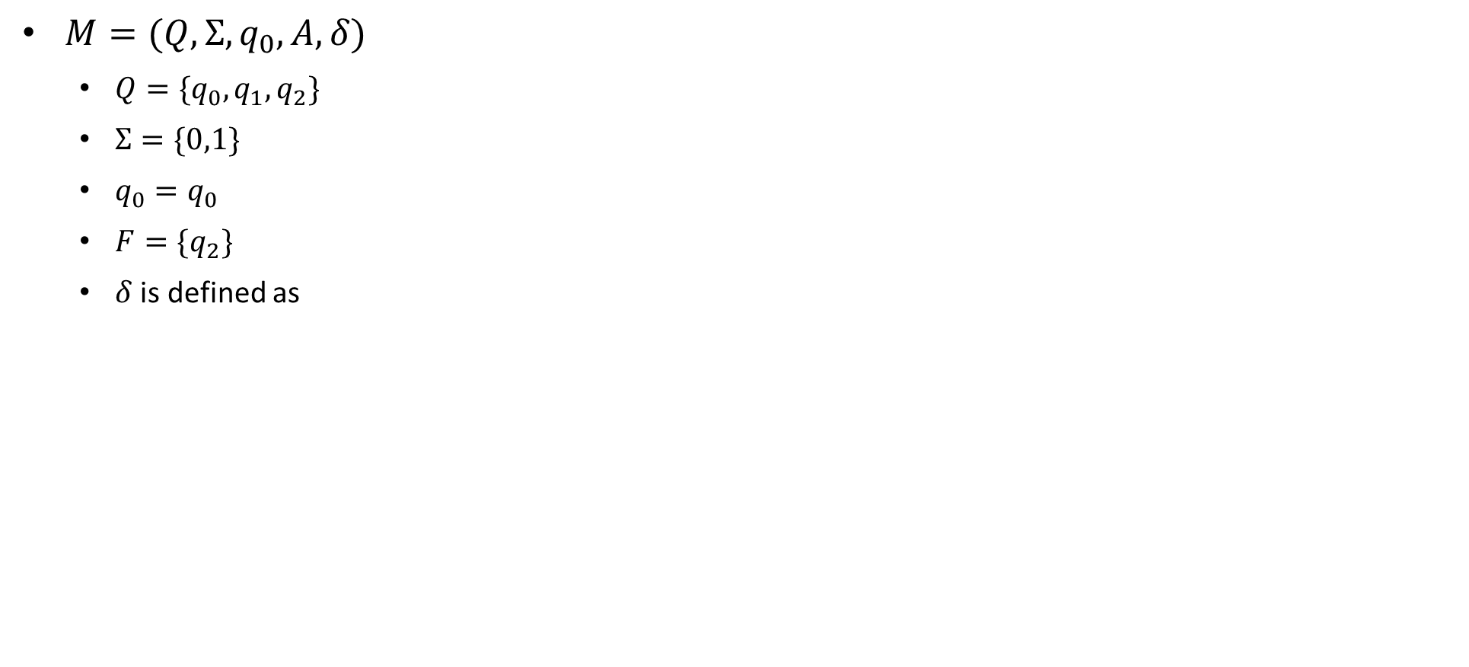
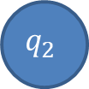
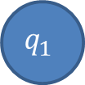
Example: Finite Automata
$M=(Q,Σ,q_{0},A,δ)$
  $Q=\{q_{0},q_{1},q_{2}\}$
  $Σ=\{0,1\}$
  $q_{0}=q_{0}$
  $F=\{q_{2}\}$
  $δ$ is defined as
Transition Table
δ | Input
State | $$0$$ | $$1$$
$$q_{0}$$ | $$q_{1}$$ | $$q_{0}$$
$$q_{1}$$ | $$q_{2}$$ | $$q_{0}$$
$$q_{2}$$ | $$q_{2}$$ | $$q_{0}$$
1
1
0
$$q_{0}$$
0
$$q_{1}$$
0
$$q_{2}$$
1
Why we are changing state, because FA does not have their own memory. So to remember the input we need to change the state.
Transition State Diagram

Slide 30
Minimum states
Calculate the length of substring.
All strings ending with ‘n’ length substring will always require minimum (n+1) states in the DFA.
All strings starting with ‘n’ length substring will always require minimum (n+2) states in the DFA.

Slide 31
Problem types
Staring with w
Ending with w
w as sub string
w with |w|=2 or 3 or n

Slide 32
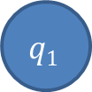
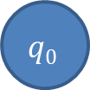
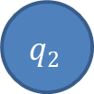
DFA Example: ending with w
The strings ending with 10.
0
1
0
$$q0$$
1
$$q1$$
$$q2$$
1
0

Slide 33
DFA Example: ending with w
The string ending in 10 or 11
1
C
0
1
A
1
B
0
0
1
D
0

Slide 34
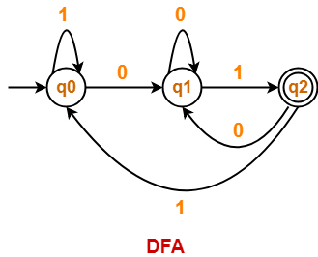
DFA Example: ending with w
Draw a DFA for the language accepting strings ending with ’01’ over input alphabets ∑ = {0, 1}
Regular expression for the given language = (0 + 1)*01
Minimum length=2
  Minimum number of states required in the DFA = 2 + 1 = 3.

Slide 35
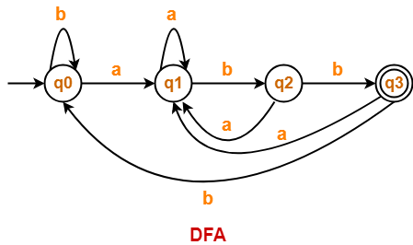
DFA Example: ending with w
Draw a DFA for the language accepting strings ending with ‘abb’ over input alphabets ∑ = {a, b}
Regular expression for the given language = (a + b)*abb
Minimum number of states required in the DFA = 3 + 1 = 4.

Slide 36
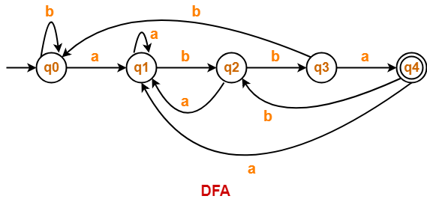
DFA Example: ending with w
Draw a DFA for the language accepting strings ending with ‘abba’ over input alphabets ∑ = {a, b}
Regular expression for the given language = (a + b)*abba
Minimum number of states required in the DFA = 4 + 1 = 5.

Slide 37
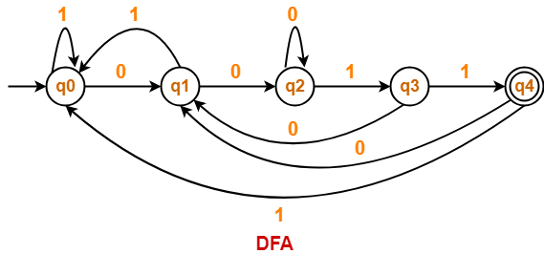
DFA Example: ending with w
Draw a DFA for the language accepting strings ending with ‘0011’ over input alphabets ∑ = {0, 1}
Regular expression for the given language = (0 + 1)*0011
Minimum number of states required in the DFA = 4 + 1 = 5

Slide 38
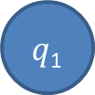




DFA Examples: ends with w
Draw a DFA that accepts a language L over input alphabets ∑ = {a, b} such that L is the set of all strings have last two symbols are same.
Regular expression for the given language = (a + b)*bb + (a + b)*aa
L={aa, bb, aaa, abb, baa, bbb, ….}
a
$q$₁
a
$q$₃
a
b
$$q0$$
b
a
a
b
$q$₂
$$q4$$
b
b
Draw a DFA that accepts a language L over input alphabets ∑ = {a, b} such that L is the set of all strings have last two symbols are different?.

Slide 39


DFA Examples: ends with w
Draw a DFA that accepts a language L over input alphabets ∑ = {a, b} such that L is the set of all strings that
  Starts and ends with same symbol.
    L={ε, a, b, aa, bb, aba, bab, ababa, aabba, aaabbba,...}
  Starts and ends with different symbol.
    L = {ab, ab, abab, aabb, aaabbb,...}

Slide 40

DFA Examples: starting with w
Draw a DFA for the language accepting strings starting with ‘ab’ over input alphabets ∑ = {a, b}
Regular expression for the given language = ab(a + b)*
Minimum number of states required in the DFA = 2 + 2 = 4.

Slide 41

DFA Examples: starting with w
Draw a DFA for the language accepting strings starting with ‘a’ over input alphabets ∑ = {a, b}
Regular expression for the given language = a(a + b)*
Minimum number of states required in the DFA = 1 + 2 = 3.
  We will construct DFA for the following strings-
  a
  aa

Slide 42

DFA Examples: starting with w
Draw a DFA for the language accepting strings starting with ‘101’ over input alphabets ∑ = {0, 1}
Regular expression for the given language = 101(0 + 1)*
Minimum number of states required in the DFA = 3 + 2 = 5
  We will construct DFA for the following strings-
  101
  1011
  10110
  101101

Slide 43

DFA Examples: starting with w
Draw a DFA that accepts a language L over input alphabets ∑ = {0, 1} such that L is the set of all strings starting with ’00’.
Regular expression for the given language = 00(0 + 1)*
Minimum number of states required in the DFA = 2 + 2 = 4
  We will construct DFA for the following strings-
  00
  000
  00000

Slide 44

DFA Examples: starting with w
Construct a DFA that accepts a language L over input alphabets ∑ = {a, b} such that L is the set of all strings starting with ‘aa’ or ‘bb’.{initial two letter are same}
Regular expression for the given language = (aa + bb)(a + b)*
Minimum number of states required in the DFA = 5.
  We will construct DFA for the following strings-
  aa
  aaa
  aaaa
  bb
  bbb
  bbbb

Slide 45

DFA Examples: starting with w
Construct a DFA that accepts a language L over input alphabets ∑ = {a, b} such that L is the set of all strings starting with ‘aba’.
Regular expression for the given language = aba(a + b)*
Minimum number of states required in the DFA = 3 + 2 = 5.
  We will construct DFA for the following strings-
  aba
  abaa
  abaab
  abaaba

Slide 46


DFA Examples: in between
The string with next to last symbol as 0.
0
1
$$q2$$
0
$$q0$$
0
$$q1$$
1
1
$$q3$$
0
1

Slide 47
DFA Examples: starts and ends with
The string corresponding to Regular expression {00}*{11}*
0,1
B
1
D
0
0
0
0
1
A
1
C
E
1

Slide 48
DFA Examples: starts and ends with
(a+b)*baaa
b
a
B
a
b
A
b
C
b
b
a
a
E
a
D

Slide 49




DFA Examples: starts and ends with
Draw a DFA that accepts a language L over input alphabets ∑ = {a, b} such that L is the set of all strings that starts with a and ends with b.
Regular expression for the given language = a(a + b)*b
L={ab, aab, abb, aabb, abab, ….}
a
b
$$q0$$
a
$q$₁
b
$q$₂
a
b
$q$₃
a, b

Slide 50


DFA Examples: starts and ends with
All strings over {0, 1} that begin or end with 111
All strings over {0, 1} that begin and end with 111

Slide 51



DFA Examples: of length w
Construct a DFA which accepts set of all strings over Σ={a,b} of length 2 , L = {aa, ab, ba, bb}
Construct a DFA which accepts set of all strings over Σ={a,b} of length ≥2
Construct a DFA which accepts set of all strings over Σ={a,b} of length ≤2

Slide 52






DFA Examples: of length w
Construct a DFA which accepts set of all strings over Σ={a, b} such that every string accepts must |w|=2 mod 3.
|w|=3 mod 4..?
|w|=2 mod 3
|w|_{b}=2 mod 3 (number of b should give 2 as remainder by 3)
a
a
a, b
$$q0$$
b
$$q1$$
$$q0$$
$$q1$$
a, b
b
b
a, b
$$q2$$
$$q2$$
a

Slide 53





DFA Examples: of length w
Construct a DFA which accepts set of all strings over Σ={a, b} such that every string starting with ab and must |w|=2 mod 3.(merge two DFA)
$$q6$$
a, b
a, b
$$q0$$
a
$$q1$$
b
$$q3$$
a, b
$$q4$$
a, b
$$q5$$
a
a
$$q2$$
a, b

Slide 54
DFA Examples: even or odd occurrence
The string with number of 0’s and number of 1’s are even
The string with number of 0’s and number of 1’s are odd ?
1
odd 0
odd 1
odd 0
even 1
1
0
0
0
0
1
odd 1
even 0
even 1
even 0
1

Slide 55

Minimization of DFA
The process of elimination of states whose presence or absence does not affects the language accepting capability of DFA. It is always unique for a language.
The process of reducing a given DFA to its minimal form is called as minimization of DFA.
  It contains the minimum number of states.
  The DFA in its minimal form is called as a Minimal DFA
How To Minimize DFA?
The two popular methods for minimizing a DFA are-

Slide 56
Minimization of DFA Using Equivalence Theorem-
Step-01: Eliminate all the dead states(keep one) and inaccessible states from the given DFA (if any).
  Dead State: All those non-final states which transit to itself for all input symbols in ∑ are called as dead states.
  Inaccessible State: All those states which can never be reached from the initial state are called as inaccessible states.
Step-02:
  Draw a state transition table for the given DFA.
  Transition table shows the transition of all states on all input symbols in Σ.
Step-03:
  Take a counter variable k and initialize it with value 0.
  Divide Q (set of states) into two sets such that one set contains all the non-final states and other set contains all the final states.
  This partition is called P₀.

Slide 57
Step-04:
  Increment k by 1.
  Find P_{k} by partitioning the different sets of P_{k-1} .
  In each set of P_{k-1} , consider all the possible pair of states within each set and if the two states are distinguishable, partition the set into different sets in P_{k}.
    Two states q₁ and q₂ are distinguishable in partition P_{k} for any input symbol ‘a’,
    if δ (q₁, a) and δ (q₂, a) are in different sets in partition P_{k-1}.
Step-05:
  Repeat step-04 until no change in partition occurs.
  In other words, when you find P_{k} = P_{k-1}, stop.
Step-06:
  All those states which belong to the same set are equivalent.
  The equivalent states are merged to form a single state in the minimal DFA
Number of states in Minimal DFA = Number of sets in P_{k}

Slide 58



Problem 1
Step 1: The given DFA contains no dead states and inaccessible states.
Step 2: Draw a state transition table-
Step 3: Now using Equivalence Theorem, we have-
P0 = { q0 , q1 , q2 , q3 } { q4 } :set of final and non final
P1 = { q0 , q1 , q2 } { q3 } { q4 } :behavior or transition of q3 on input {a, b} is different from q0,q1,q2
P2 = { q0 , q2 } { q1 } { q3 } { q4 } :behavior or transition of q3 on input {a, b} is different from q0,q1,q2
P3 = { q0 , q2 } { q1 } { q3 } { q4 }
Since P3 = P2, so we stop.
From P3, we infer that states q0 and q2 are equivalent and can be merged together.
So, Our minimal DFA is-

Slide 59




Problem 2
Step-01: State q₃ is inaccessible from the initial state.
So, we eliminate it and its associated edges from the DFA.
Step-02: Draw a state transition table-
Step-03:
Now using Equivalence Theorem, we have-
P₀ = { q₀ } { q₁ , q₂ }
P₁ = { q₀ } { q₁ , q₂ }
Since P₁ = P₀, so we stop.
From P₁, we infer that states q₁ and q₂ are equivalent and can be merged together.
So, Our minimal DFA is-

Slide 60




Problem 3, 4

Slide 61




Problem 5
0
0
0,1
$$a$$
1
$$c$$
1
$$f$$

Slide 62





Nondeterministic Finite Automata (NFA)
A nondeterministic finite automaton is a 5-tuple $M=(Q,Σ,q_{0},F,δ)$
  $Q$ is finite set of states;
  $Σ$ is finite set of input symbols called Input Alphabets;
  $q_{0} ε Q$ (initial state);
  $F⊆Q$ (the set of accepting states of final states);
  $δ$ is a function from $Q×Σ →2Q$ (the transition function).
If $Σ$={a,b}$then 2^{Q}$ : {ɸ, {a}, {b}, {a,b} }
$$q0$$
$$q0$$
a
$$q0$$
$$q0$$
a
a
$$q0$$

Slide 63
Why we need non deterministic
All machines around us are deterministic
Theoretical model is possible, but actual implementation is not possible
We do not have software or hardware that work as non deterministically
Why it is important…???
NFA
DFA
Minimal DFA
Design complexity

Slide 64
Regular
Grammar
Regular
Language
If any regular language in the world DFA is possible then NFA is also possible and vice-versa
Every DFA is also a NFA
We can convert every NFA to DFA
For all
Finite Automata
For all
DFA
NFA
= power

Slide 65






Acceptance by NFA
A string w is said to be accepted by NFA if there exist at least one transition path on which we start at initial state and ends at final state.
$δ$*(q₀,w) = F
a, b
a, b
$$q0$$
a
$q$1
$$q0$$
a
$q$1
b
a
$q$2
a, b
$q$2
a, b

Slide 66




Example

Slide 67






Example of NFA for ${\{11+110\}}^{∗}\{0\}$
$$M=(Q,Σ,q_{0},A,δ)$$
  $Q=\{q_{0},q_{1},q_{2},q_{3},q_{4}\}$
  $Σ=\{0,1\}$
  $q_{0}=q_{0}$
  $A=\{q_{4}\}$
  $δ$ is defined as
δ | Input
State | $$0$$ | $$1$$
$$q_{0}$$ | $$\{q_{4}\}$$ | $${\{q}_{1},q_{2}\}$$
$$q_{1}$$ | $$∅$$ | $$\{q_{0}\}$$
$$q_{2}$$ | $$∅$$ | $$\{q_{3}\}$$
$$q_{3}$$ | $${\{q}_{0}\}$$ | $$∅$$
$$q_{1}$$
$$q_{4}$$ | $$∅$$ | $$∅$$
1
1
$$q_{0}$$
0
$$q_{4}$$
1
0
$$q_{2}$$
$$q_{3}$$
1

Slide 68


NFA: ending with w
NFA that accepts all binary strings that end with 101.
Accepts all binary strings where the last symbol is 0 or that contain only 1’s.

Slide 69


Examples
Design a NFA of all binary strings in which 2nd last bit is 1.
  L= {10, 010, 000010, 11, 101011……..}
Design an NFA with ∑ = {0, 1} accepts all string ending with 01.
  L= {01, 0101, 0000101, 101, 101001……..}

Slide 70
NFA to DFA conversion
Steps For Converting NFA to DFA
There are five basic steps for conversion of NFA to DFA.
Step 01: Draw NFA.
Step 02: Draw NFA transition Table.
Step 03: Now convert NFA transition Table To its corresponding DFA transition Table.
Step 04: Through DFA transition Table draw DFA.
Step 05: If “q_{k}” was the final state in NFA, then all those states will be the final in DFA where “q_{k}” exist.

Slide 71


Example 1
State | a | b
→q0 | q0 | q0, q1
q1 | – | *q2
*q2 | – | –
Since no new states are left to be added in the transition table T’, so we stop.
States containing q2 as its component are treated as final states of the DFA
Let T’ be a new transition table of the DFA. Add transitions of start state q0 to the transition table T’.
State | a | b
→q0 | q0 | {q0, q1}
{q0, q1} | q0 | *{q0, q1, q2}
*{q0, q1, q2} | q0 | *{q0, q1, q2}
State | a | b
→q0 | q0 | {q0, q1}
New state present in state Q’ is {q0, q1}. Add transitions for set of states {q0, q1} to the transition table T’.
State | a | b
→q0 | q0 | {q0, q1}
{q0, q1} | q0 | {q0, q1, q2}
New state present in state Q’ is {q0, q1, q2}. Add transitions for set of states {q0, q1, q2} to the transition table T’.
State | a | b
→q0 | q0 | {q0, q1}
{q0, q1} | q0 | {q0, q1, q2}
{q0, q1, q2} | q0 | {q0, q1, q2}

Slide 72
(Epsilon) ∈-NFA
An epsilon nondeterministic finite automaton (NFA) has null or epsilon transitions from one state to another. Epsilon NFA is also called a null NFA or an NFA lambda.
A regular expression for a language forms an epsilon NFA. This epsilon NFA then converts to a simple NFA. We then use the simple NFA to make a deterministic finite automaton (DFA)
Null closure: We require null closure to convert an epsilon NFA to an NFA. Moreover, it shows us the states we can transcend due to a null transition.

Slide 73
Let's suppose an NFA < Q, Σ, q0​​, δ, F > and S ⊆ Q is a defined set of states, where:
Q is the finite set of states
Σ is the input symbols
q0​ is the start state
δ is the transition function
F is the final state
The null closure of S is the set Λ(S). We can define it recursively as follows:
S⊆Λ(S)
For every q∈Λ(S), δ(q,Λ)⊆Λ(S)

Slide 74

Example
Consider the following epsilon NFA, where q0​ is the start state
Null closure
State | Set
q0 | {q0, q1, q3}
q1 | {q1, q3}
q2 | {q2}
q3 | {q3}
Q = {q0​, q1​, q2​, q3​}
Σ = (0,1)
F = {q3​}
We determine this null closure by how a transition transcends from one state to another with a null input.

Slide 75
epsilon NFA to NFA
To convert an epsilon NFA to NFA, the null closure method makes use of the following general set of rules.
Find the null closures for each state.
For each state, check for the transitions by the null closures obtained, the given input, and then the null closures again. This eliminates any potential null closures that can occur.
Make an NFA by the transitions obtained in the previous step. The final state will be all those states that have F in them.

Slide 76


Example
Consider the following epsilon NFA, q0​ is the start state.
Step 1: Find null closure of all states
Step 2: Follow the process of null closure, input, null closure
Implement the process for all states for the given inputs in order.
Transitions
Step 3: Result
Q={q0​, q1​, q2​, q3​}
Σ=(0,1)
F={q3​}
state | set
q0 | {q0, q1, q3}
q1 | {q1, q3}
q2 | {q2}
q3 | {q3}
state | 0 | 1
q0 | {q0, q1, q2, q3} | -
q1 | {q2, q3} | -
q2 | - | {q1, q3}
q3 | {q3} | -

Slide 77

Converting DFA to regular expression
The two popular methods for converting a given DFA to its regular expression are-

Slide 78
Arden’s Theorem-
Arden’s Theorem is popularly used to convert a given DFA to its regular expression.
It states that-
Let P and Q be two regular expressions over ∑.
If P does not contain a null string ∈, then-
    R = Q + RP has a unique solution i.e. R = QP*
Conditions-
To use Arden’s Theorem, following conditions must be satisfied-
The transition diagram must not have any ∈ transitions.
There must be only a single initial state.

Slide 79
Steps-
To convert a given DFA to its regular expression using Arden’s Theorem, following steps are followed-
Step-01:
Form a equation for each state considering the transitions which comes towards that state.
Add ‘∈’ in the equation of initial state.
Step-02:
Bring final state in the form R = Q + RP to get the required regular expression.
Important Notes-
  Note-01:
  Arden’s Theorem can be used to find a regular expression for both DFA and NFA.
  Note-02:
  If there exists multiple final states, then-
    Write a regular expression for each final state separately.
    Add all the regular expressions to get the final regular expression.

Slide 80

Example 1
Find regular expression for the following DFA using Arden’s Theorem-
Step-01: Form a equation for each state-
  A = ∈ + B.1 ……(1)
  B = A.0 ……(2)
Step-02: Bring final state in the form R = Q + RP.
  Using (1) in (2), we get-
  B = (∈ + B.1).0
  B = ∈.0 + B.1.0
  B = 0 + B.(1.0) ……(3)
  Using Arden’s Theorem in (3), we get-
  B = 0.(1.0)*
  Thus, Regular Expression for the given DFA = 0(10)*

Slide 81

Example 2
Find regular expression for the following DFA using Arden’s Theorem-
Step-01:Form a equation for each state-
  q1 = ∈ ……(1)
  q2 = q1.a ……(2)
  q3 = q1.b + q2.a + q3.a …….(3)
Step-02:Bring final state in the form R = Q + RP.
  Using (1) in (2), we get-
  q2 = ∈.a
  q2 = a …….(4)
  Using (1) and (4) in (3), we get-
  q3 = q1.b + q2.a + q3.a
  q3 = ∈.b + a.a + q3.a
  q3 = (b + a.a) + q3.a …….(5)
  Using Arden’s Theorem in (5), we get-
  q3 = (b + a.a)a*
  Thus, Regular Expression for the given DFA = (b + aa)a*

Slide 82


Practice problem
(b + a.b*.a)*
(a + b(b + ab)*aa)*

Slide 83


State elimination method
Rule 1 :There must be only one initial state, and there should not be any incoming edges to it.
  If there is more than one initial state, convert all initial states to non-initial states and create a new single initial state.
  If there are incoming edges to the initial state, create a new initial state with no incoming edges.
Rule 2 :There must be only one final state.
  If there is more than one final state, convert all final states to non-final states and create a new single final state.

Slide 84

Rule 3 :From the final state, there should be no outgoing edges.
  If there are outgoing edges from the final state, convert all final states to non-final states and create a new final state having no outgoing edges.
Rule 4: After verifying rules 1 to 3, all intermediate states are eliminated one by one. We can eliminate these intermediate states in any order.

Slide 85




Example 1

Slide 86























Short trick
a⁺
(a+b)*
a*b*
(ab)*
a*.b
a.b*
a* b c*
$$q_{0}$$
a
$$q_{1}$$
a
a,b
Ф
Є
a
a+b
a.b
a*
$$q_{0}$$
$$q_{0}$$
a
b
$$q_{0}$$
$$q_{0}$$
Є
$$q_{1}$$
$$q_{0}$$
a
$$q_{1}$$
ab
a
$$q_{0}$$
$$q_{0}$$
$$q_{1}$$
b
a
$$q_{0}$$
$$q_{1}$$
$$q_{0}$$
b
$$q_{1}$$
b
a
a
b
b
$$q_{0}$$
$$q_{1}$$
$$q_{2}$$
$$q_{0}$$
a
$$q_{1}$$
a
a
c
$$q_{0}$$
$$q_{0}$$
b
$$q_{1}$$

Slide 87

















a
a,b
a*b(a+b)*
(ab)* a b*
(a+ba)*ba
(aa+aaa)*
b
$$q_{0}$$
$$q_{1}$$
$$q_{2}$$
ab
a b
b
b
$$q_{0}$$
a
$$q_{1}$$
$$q_{0}$$
a
$$q_{1}$$
$$q_{3}$$
a+ba
b a
$$q_{0}$$
b
$$q_{1}$$
a
$$q_{2}$$
$$q_{0}$$
b
$$q_{1}$$
a
$$q_{2}$$
$$q_{3}$$
a
aa+aaa
aa
a a
$$q_{0}$$
$$q_{0}$$
$$q_{0}$$
a
$$q_{3}$$
aaa
a
a
$$q_{3}$$

Slide 88









ab
$$q_{1}$$
Є
Є
(ab)*+(a+ab)* b* (a+b)*
[a+ba(a+b)]* a (ba)* b*
$$q_{0}$$
$$q_{2}$$
Є
$$q_{0}$$
Є
$$q_{0}$$
Є
$$q_{0}$$
a+ab
a+b
b
And now we know how to break a+ab, ab, a+b to make it appropriate NFA
a+ba(a+b)
ba
b
$$q_{0}$$
a
$$q_{1}$$
Є
$$q_{2}$$
And now we know how to break a+ba(a+b),and ba to make it appropriate NFA

Slide 89
Grammar
Set of rules used to describe strings of a language is called as Grammar. Hence for every language grammar exist.
A Grammar is a 4-tuple such that-
G = (V , T , P , S)
where-
  V = Finite non-empty set of non-terminal symbols or variables
  T = Finite set of terminal symbols
  P = Finite non-empty set of production rules
  S = Start symbol

Slide 90
Grammar constituents: A Grammar is mainly composed of two basic elements-
  1. Terminal Symbols-
  Terminal symbols are those which are the constituents of the sentence generated using a grammar.
  Terminal symbols are denoted by using small case letters such as a, b, c etc.
  2. Non-Terminal Symbols-
  Non-Terminal symbols are those which take part in the generation of the sentence but are not part of it.
  Non-Terminal symbols are also called as auxiliary symbols or variables.
  Non-Terminal symbols are denoted by using capital letters such as A, B, C etc.
Production Rules :
A production or production rule is a rule specifying a symbol substitution that can be recursively performed to generate new symbol sequences.
It is of the form α → β where α is a Non-Terminal Symbol which can be replaced by β which is a string of Terminal Symbols or Non-Terminal Symbols.

Slide 91
Example
Example-01:
Consider a grammar G = (V , T , P , S) where-
  V = { S } // Set of Non-Terminal symbols
  T = { a , b } // Set of Terminal symbols
  P = { S → aSbS , S → bSaS , S → ∈ } // Set of production rules
  S = { S } // Start symbol
This grammar generates the strings having equal number of a’s and b’s
Example-02:
Consider a grammar G = (V , T , P , S) where-
  V = { S , A , B } // Set of Non-Terminal symbols
  T = { a , b } // Set of Terminal symbols
  P = { S → ABa , A → BB , B → ab , AA → b } // Set of production rules
  S = { S } // Start symbol

Slide 92
Identify language represented by following grammar
S → aS|bS|∈
Sol: L={∈, a, b, aa, bb, ab, ba, …} = (a+b)*
S → aS | bS |a
Sol: (a+b)* a
S → aSb |∈
Sol: L= {∈, ab, aabb,…} = a^{n}b^{n} ,n>=0
S → aSa | bSb | ∈
L= {aa, bb, abba, baab..} = L={even length palindrome}
S → aSa | bSb | a|b
L={odd length palindrome}

Slide 93
S → aSbS | bSaS |∈
Sol: L={ equal number of a and b}
S →aSb|aAb (a)aabb (b) aaabb
A→ bA|b (c)aabbb (d)aaaabbb
Find the grammar that generates all strings that’s starts with a and ends with b.
Sol:
  S→aAb
  A→aA | bA | ∈
Find the grammar for which length of each string is exactly 3
Sol:
  S→ AAA
  A→a|b

Slide 94
Find the grammar that generates the words whose length atmost 4.
S→ AAAA
A→ a|b|∈
Find the grammar that generates the words whose length divisible by 3.
S→ AS |∈
A →BBB
B → a|b
Find the grammar that generates the words contains 0, 1 where number of 0 are divisible by 3
(1*0 1*0 1*0 1*)*+1*
S→ AS|B|∈
A→ B0B0B0B
B→ 1B|∈

Slide 95
L={a^{n}b^{m}c^{m}d^{n}|n,m>=1}
S→aAd|aSd
A→bAc|bc
L={a^{m+n}b^{n}c^{m}|n,m>=1}
S→aAc| aSc
A→ aAb|ab
L={a^{m}b^{m+n}c^{n}|n,m>=1}
S→AB
A→aAb|ab
B→bBc|bc

Slide 96
Left most and right most derivation
A derivation in which leftmost non terminal is replaced by terminal at each step is called as leftmost derivation in Automata.
A derivation in which rightmost non terminal is replaced by terminal at each step is called as rightmost derivation in Automata.
The representation of leftmost derivation in the form of tree is called as a leftmost derivation tree.
In the leftmost derivation tree, we read the given input string (W) from left to right.

Slide 97










Consider the following production rules for the grammar (G)
S → xB / yA
S → xS / yAA / x
B → yS / xBB / y
Consider a string W = xxxyyxyyyx
Let us derive the given string (W= xxxyyxyyyx) by using given production rules of grammar. And will also draw the derivation tree of each step as given below

Slide 98

Types of grammar

Slide 99

According to the given hierarchy, Grammar is divided into four types
Type 0 | Unrestricted Grammar
Type 1 | Context-Sensitive Grammar
Type 2 | Context-Free Grammar
Type 3 | Regular Grammar

Slide 100
Type 0: Unrestricted Grammar
Language recognized by Turing Machine is known as Type 0 Grammar. They are also known as Recursively Enumerable Languages.
Grammar Production for Type 0 is given by
α —> β
For Example:
Sba —> a
S —> B
Where S and B are Variables.
And a and b are Terminals.

Slide 101
Type 1: Context-Sensitive Grammar
Languages recognized by Linear Bound Automata are known as Type 1 Grammar. Context-sensitive grammar represents context-sensitive languages.
For grammar to be context-sensitive, it must be unrestricted. Grammar Production for Type 1 is given by
α —> β (|α|<| β| ensuring count symbol in LHS must be less than or equal to RHS)
For Example,
S —> BA
BA —> bca
B —> b

Slide 102
Type 2: Context-Free Grammar
Languages recognized by Pushdown Automata are known as Type 2 Grammar. Context-free grammar represents context-free languages.
For grammar to be context-free, it must be context-sensitive. Grammar Production for Type 2 is given by
A —> α
Where A is a single non-terminal.
For Example,
A —> aB
B —> b

Slide 103
Type 3: Regular Grammar
Languages recognized by Finite Automata are known as Type 3 Grammar. Regular grammar represents regular languages.
They have a single non-terminal symbol on the left-hand side, a single terminal on the right-hand side, or a single terminal followed by a non-terminal.
Regular Grammar accepts and generates regular languages.
All the productions should be in the form of:
  A –> xB
  A –> x
  A –> Bx
where A, B ∈ V (Set of Variables), and x ∈ T*, i.e., the string of terminals.

Slide 104
Grammar | Language | Automata | Production Rule
Type 0 | Recursive Enumerable | Turing machine | No restriction α —> β α, β Є (V+T)⁺
Type 1 | Context sensitive | Linear bounded automata | α —> β where |α|<=| β| α, β Є (V+T)⁺
Type 2 | Context Free | Push down automata | α —> β where α is a single non terminal β Є (V+T)⁺
Type 3 | Regular | Finite automata | A -> a or A -> aB or A -> Ba A -> ɛ

Slide 105

1. Ambiguous Grammar-
A grammar is said to ambiguous if for any string generated by it, it produces more than one-
  Parse tree
  Or derivation tree
  Or syntax tree
  Or leftmost derivation
  Or rightmost derivation

Slide 106

Example
Consider the following grammar-
E → E + E / E x E / id (Ambiguous Grammar)
This grammar is an example of ambiguous grammar.
Any of the following reasons can be stated to prove the grammar ambiguous-
Reason-01:
Let us consider a string w generated by the grammar-
w = id + id x id
Now, let us draw the parse trees
for this string w.

Slide 107

Reason-02:
Let us consider a string w generated by the grammar-
w = id + id x id
Now, let us draw the syntax trees for this string w.
Since two syntax trees exist for string w, therefore the grammar is ambiguous.

Slide 108

Reason-03:
Let us consider a string w generated by the grammar-
w = id + id x id
Now, let us write the leftmost derivations for this string w.
Since two leftmost derivations exist for string w, therefore the grammar is ambiguous.

Slide 109

Reason-04:
Let us consider a string w generated by the grammar-
w = id + id x id
Now, let us write the rightmost derivations for this string w.
Since two rightmost derivations exist for string w, therefore the grammar is ambiguous.

Slide 110
2. Unambiguous Grammar-
A grammar is said to unambiguous if for every string generated by it, it produces exactly one-
  Parse tree
  Or derivation tree
  Or syntax tree
  Or leftmost derivation
  Or rightmost derivation
Example-
Consider the following grammar-
  E → E + T / T
  T → T x F / F
  F → id

